Slide 1

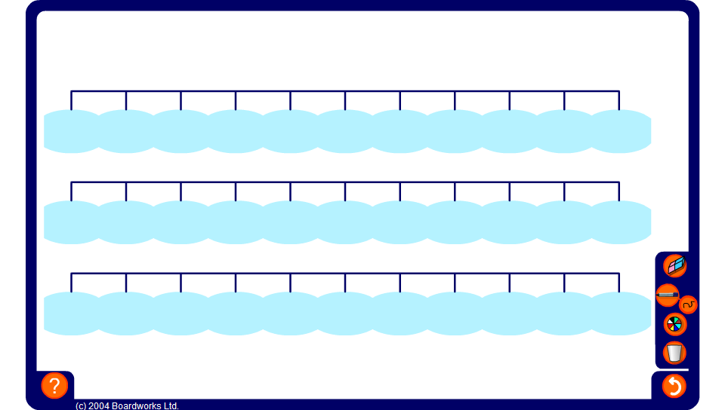


Equivalent fractions, decimals and percentages
Notes:
Start by stressing that fractions, decimals and percentages are all ways of expressing proportions of things.
Remind pupils that percent means ‘out of a hundred’. 100% means 100 out of 100 or 1 whole.
20%, for example, means 20 out of a hundred or ²⁰/₁₀₀. Ask pupils how we can write this as a fraction in its lowest terms.
Ask a volunteer to find where 20% would be positioned on the percentage number line and to reveal it on the board. Ask them to reveal the corresponding fraction, ¹/₅.
Ask how we can find the decimal equivalent of 20% or ¹/₅.
²⁰/₁₀₀ means 20 ÷ 100. By dividing we get 0.2. We could also think of ¹/₅ as ²/₁₀ and use our knowledge of place value to write this as 0.2. Remind pupils that the first digit after the decimal point tells us the number of tenths.
If 1/5 equals 20% what is ²/₅ as a percentage? And as a decimal?
Ask a volunteer to reveal these (40% and 0.4) on the board. Repeat for ³/₅ and ⁴/₅.
Continue asking pupils for equivalent fractions, decimals and percentages until the number lines are complete.
Ask a volunteer to point to where ¹/₄ and ³/₄ would be on the fraction number line. Ask for the equivalent percentages and decimals.
If ¹/₄ is 25 %, what is ¹/₈ as a a percentage?
Establish that ¹/₈ is half of ¹/₄ and therefore ¹/₈ is equivalent to half of 25% (12¹/₂% or 12.5%). The corresponding decimal is 0.125. Ask a volunteer to indicate the position of ¹/₈ , 0.125 and 12¹/₂% on the number lines on the board.
Does anyone know what ¹/₃ is as a percentage? What is ¹/₃ of 100?
100 is not divisible by three. 99 divided by three is 33 so 100 divided by three is 33¹/₃. ¹/₃ is equivalent to 33 ¹/₃%. What is this as a decimal?”
Establish that 1/3 or 33¹/₃% is equivalent to 0.3333333… (0.3 recurring). Ask a volunteer to indicate the positions of ¹/₃, 33¹/₃% and 0.3 recurring on the board.

